Slide 1
Priority Places for Food Index
Emily Ennis

Slide 2
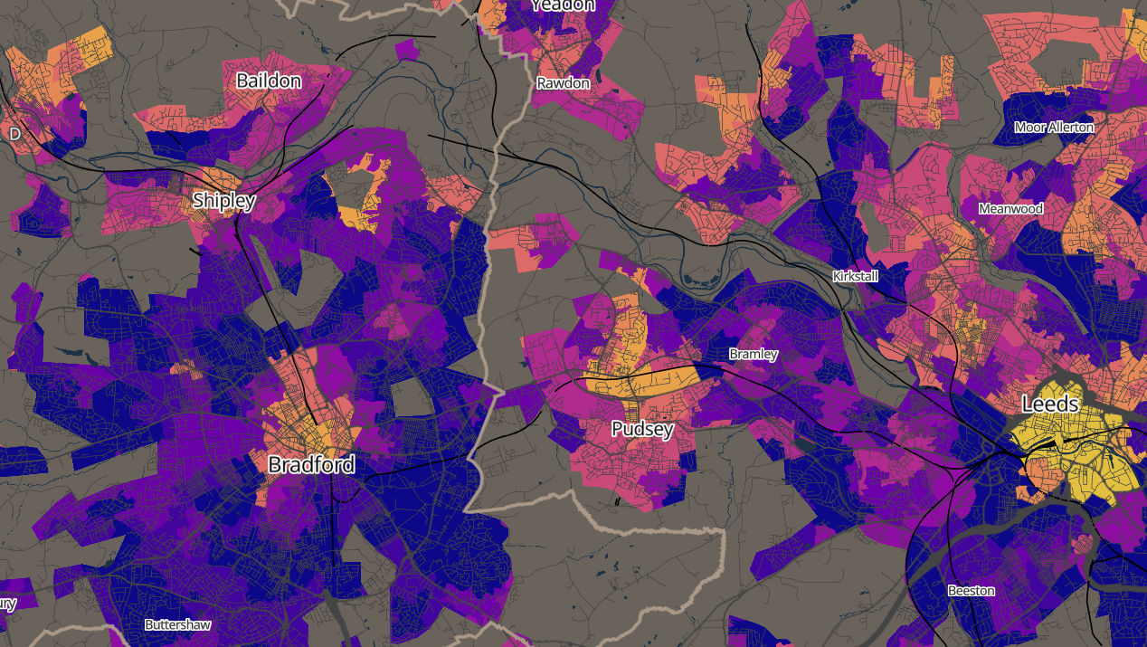
Priority Places for Food Index
Consumer Data Research Centre (University of Leeds):
Dr Michelle Morris, Associate Professor Nutrition and Lifestyle Analytics
Dr Fran Pontin, Research Data Scientist
Dr Emily Ennis, Research and Impact Manager
Dr Pete Baudains, Research Software Engineer King's College London (formerly Research Data Scientist, CDRC)
Robyn Naisbitt, Public Engagement and Communications Manager
Which?:
Sue Davies, Head of Consumer Rights and Food Policy
Stephen McDonald, Head of Economics
Denise Lovett, Economist, Strategic Insight
Parts of the video have been taken from a recording of a live online demo from November 2022

Slide 3

About CDRC
Using consumer data to provide unique insight into a diverse range of societal and economic challenges, in collaboration with a wide range of consumer data providers.

Slide 4
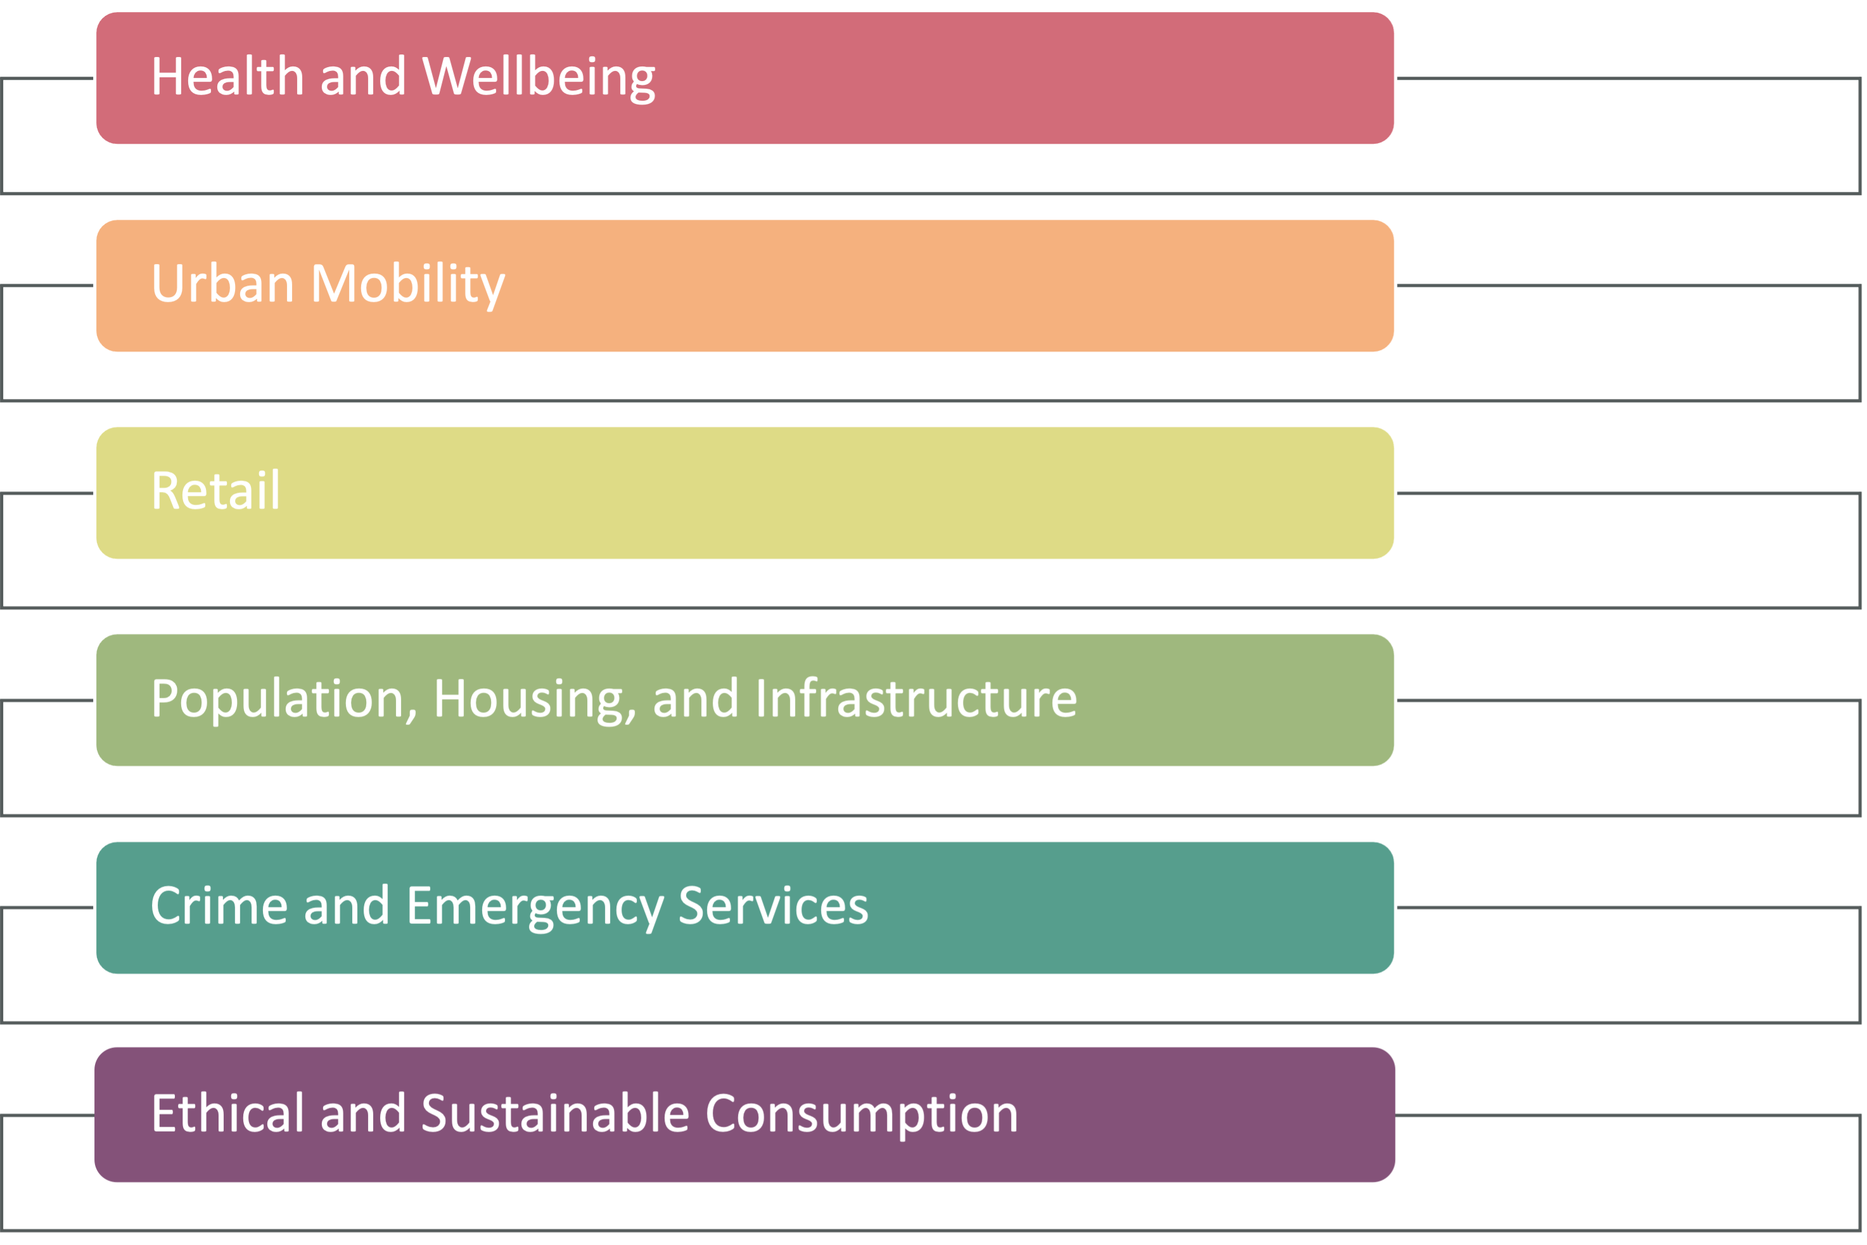
Research Themes 1
Research Themes 2
Research
Themes

Slide 5
CDRC Partners
CDRC Partners
We are collaborating with industry and public sector organisations, using consumer data to undertake cutting edge research.
Industry Partners
We're working with industry partners to better understand consumer behaviour, provide context to problems and improve strategic decision making.
Public Sector
We're working with public sector partners to provide data expertise to provide context to problems and contribute to the wider understanding of societal issues.

Slide 6

Priority Places for Food Index Methodology:
How and why the tool was developed

Slide 7







Priority Places for
Food Index
Proximity to supermarket retail facilities
Accessibility to supermarket retail facilities
Access to online deliveries
Proximity to non-supermarket food provision
Socio-economic barriers
Family food support
Fuel Poverty

Slide 8
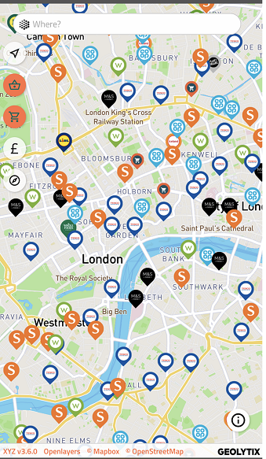
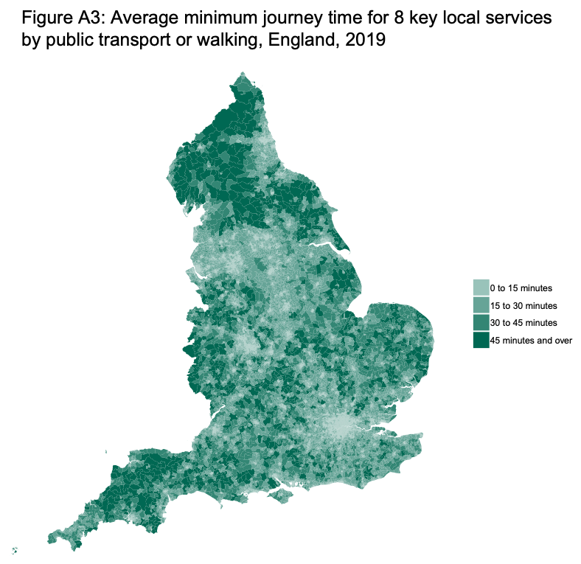



Proximity to supermarket retail facilities
Accessibility to supermarket retail facilities
E-food desert index: https://data.cdrc.ac.uk/dataset/e-food-desert-index

Slide 9

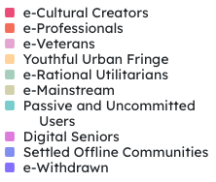


Proximity to non- supermarket food provision
Access to online deliveries
E-food desert index: https://data.cdrc.ac.uk/dataset/e-food-desert-index
Internet user classification: https://data.cdrc.ac.uk/dataset/internet-user-classification

Slide 10

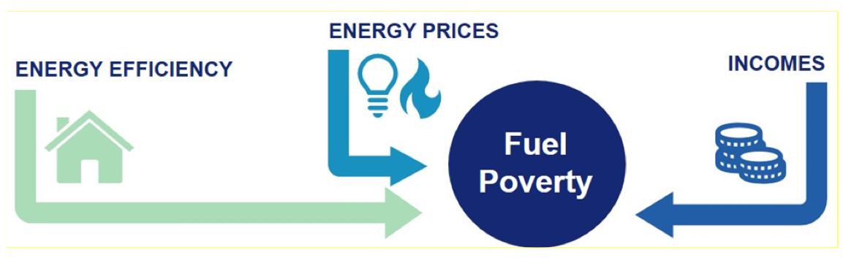
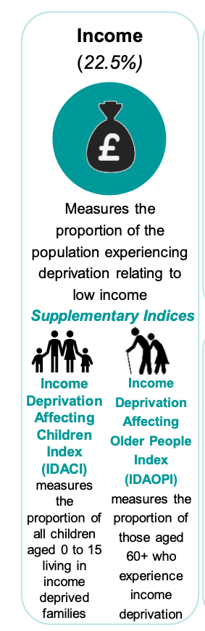

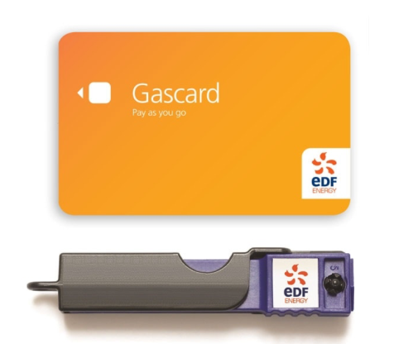
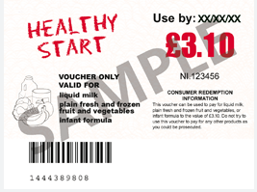

Socio-economic barriers
Family food support
Fuel Poverty

Slide 11
Priority Places for
Food Index
Proximity to supermarket retail facilities
12.5%
Accessibility to supermarket retail facilities
12.5%
Access to online deliveries
12.5%
Proximity to non- supermarket food provision
12.5%
Socio-economic barriers
16.7%
Fuel Poverty
16.7%
Family food support
16.7%
https://data.cdrc.ac.uk/dataset/priority-places-food-index

Slide 12
Tool Demonstration

Slide 13
Next Steps

Slide 14
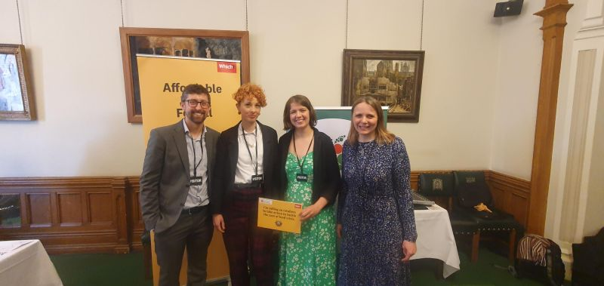
Impact
Visited online 8,400 times by 6,576 unique users
Which?’s Affordable Food For All campaign has reached over 100,000 signatures (as of 25/07/2023).
April 2023 ‘Tackling the Cost of Food Crisis’ event in House of Commons. Run jointly by Which? and The Food Foundation
Which? have built constituency-level reports for MPs, which were distributed at the Index’s launch and at HoC event in April.
Which? Have also built briefings for devolved nations
Further reading:
Priority Places for Food Index data portal (2022)
Priority Places Explorer (2023)
Pontin F., ‘Understanding Priority Places – targeted support for the UK’s hungriest neighbourhoods’, Academy of Social Sciences: Comment and Analysis
Baudains P., Pontin F., Ennis E., Morris M., ‘Priority Places for Food’, Royal Geographic Society: Geovisualisation
Being used as part of monitoring and evaluation for policymakers Being used as part of localized food strategies
Aldi committed to the campaign on social media by highlighting that it already complied with the action plan.
Being used by retailers to target high priority places Morrisons Daily have increased the number of budget line items sold in their convenience stores (Which?, July 11 2023)

Slide 15
Future and Developments
Planned autumn update each year, in time for the autumn budget.
Two further research projects through DSDP 23/24:
  Mapping health inequalities onto PPFI (partners: OHID and Good Food Oxfordshire)
  Assessing food redistribution networks using PPFI (partner: large, national food redistribution organisation)
Ongoing relationship with Which? until future notice

Slide 16
www.ncrm.ac.uk

